Slide 1
Transformations of Taiwanese People’s State Identity
APSA 2016 “Conceptualizing Difference”
Frank C.S. Liu, NSYSU, Taiwan

Slide 2
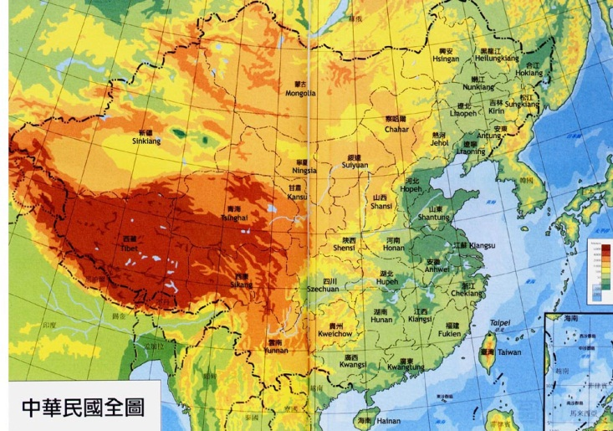

Slide 3
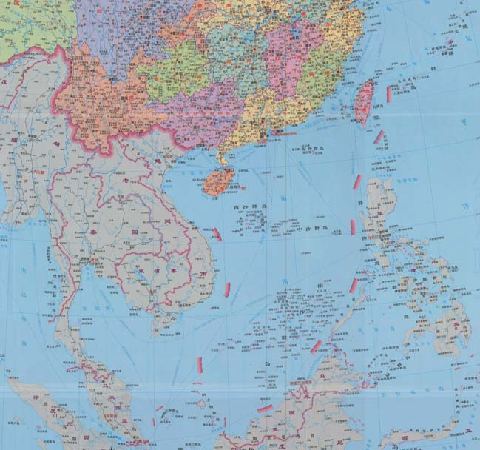

Slide 4
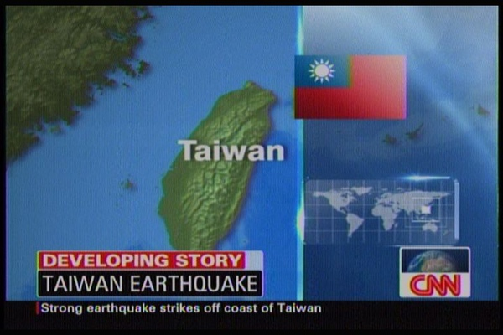
Whose Flag?

Slide 5
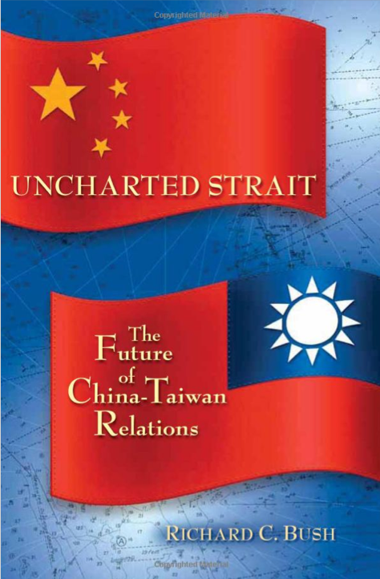

Slide 6
Taiwan, a nation-state (yet)?
The concepts of nation and state should be clarified first.

Slide 7
Taiwanese people have multiple views about
state: Taiwan or ROC?
nation: Taiwanese, Chinese, Both, or something else?
future relationship with PRC: separation, unification, or status quo?

Slide 8
So we have a good number of measurements,
But few discussion about the concept-measurement connections

Slide 9
How to measure state identification?
“Chinese/Taiwanese”? or “unification/independence”?

Slide 10
Research Questions
Are the measurements properly conceptualized?
Do the major concepts find their measurements?
  How sure are we when we associate the measurements with concepts (national/ethnic and state/country identification)?
  How to conceptualize the most commonly used survey question—unification/independence preference?
  Could we find the right indicators for the concept of national/ethnic identification?

Slide 11
Main Ideas
Revisit the Exploratory Data Analysis (EDA) approach
Explore with Multiple Correspondence Analysis (MCA) techniques
Double check patterns with multiple datasets

Slide 12
Data Sets
F2F Survey: Taiwan Social Change Survey 2013 (n=1,952)
CATI Telephone survey 2015 (n=1,100)
Web panel 2015-2016 (n=468)

Slide 13
ca & FactoMineR
Two R packages:
Notes:
Lê, S., Josse, J. & Husson, F. (2008). FactoMineR: An R Package for Multivariate Analysis. Journal of Statistical Software. 25(1). pp. 1-18. http://www.jstatsoft.org/v25/i01/
A website: http://factominer.free.fr/

Slide 14
Main Findings
We have many survey questions but not many concepts.
Another emerging but neglected dimension is associated with acknowledging or rejecting the legacy of the Republic of China.
The commonly used measurement “unification/independence” preference cannot be well conceptualized.

Slide 15
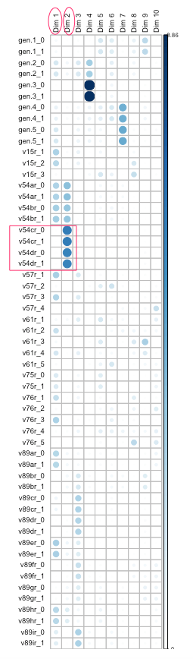
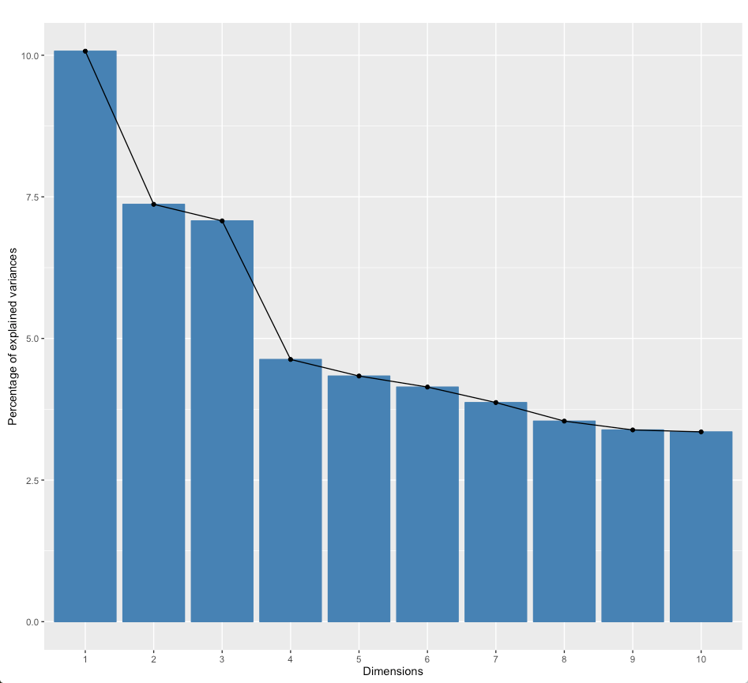
TSCS2013
TSCS2013

Slide 16
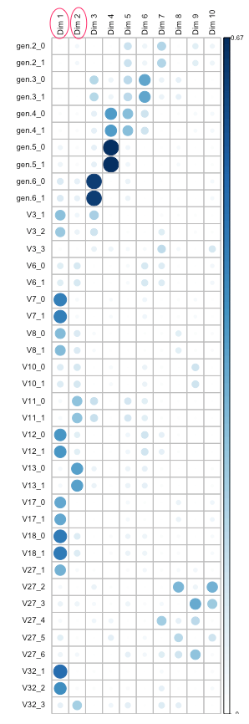
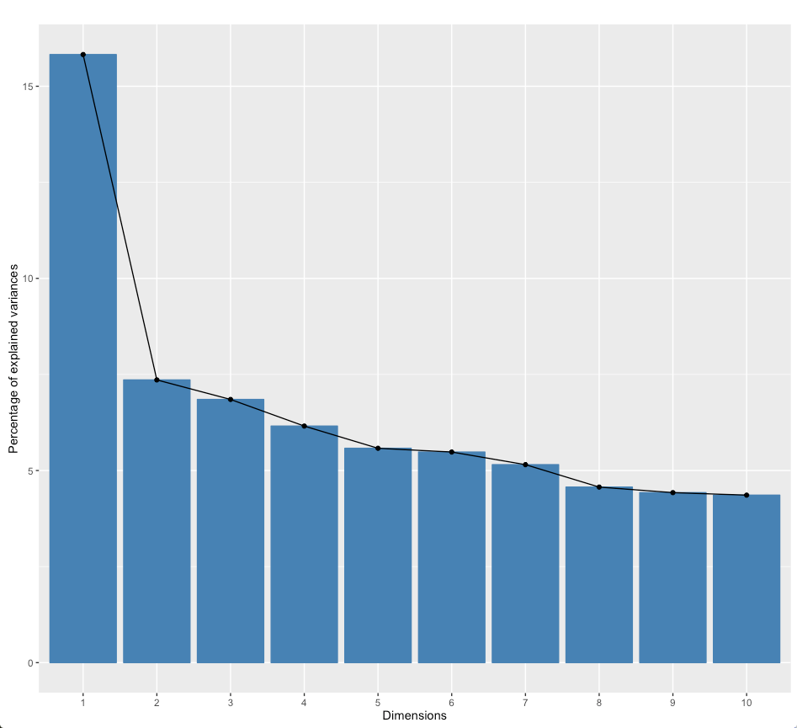
ID2015

Slide 17
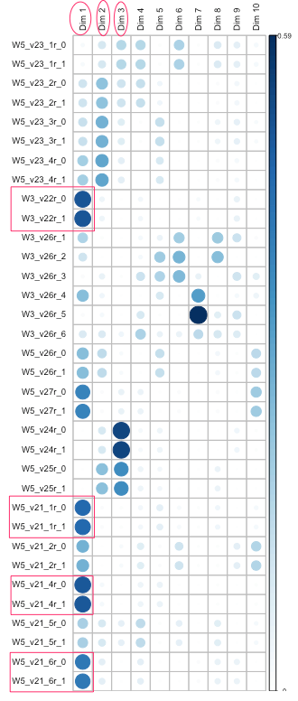
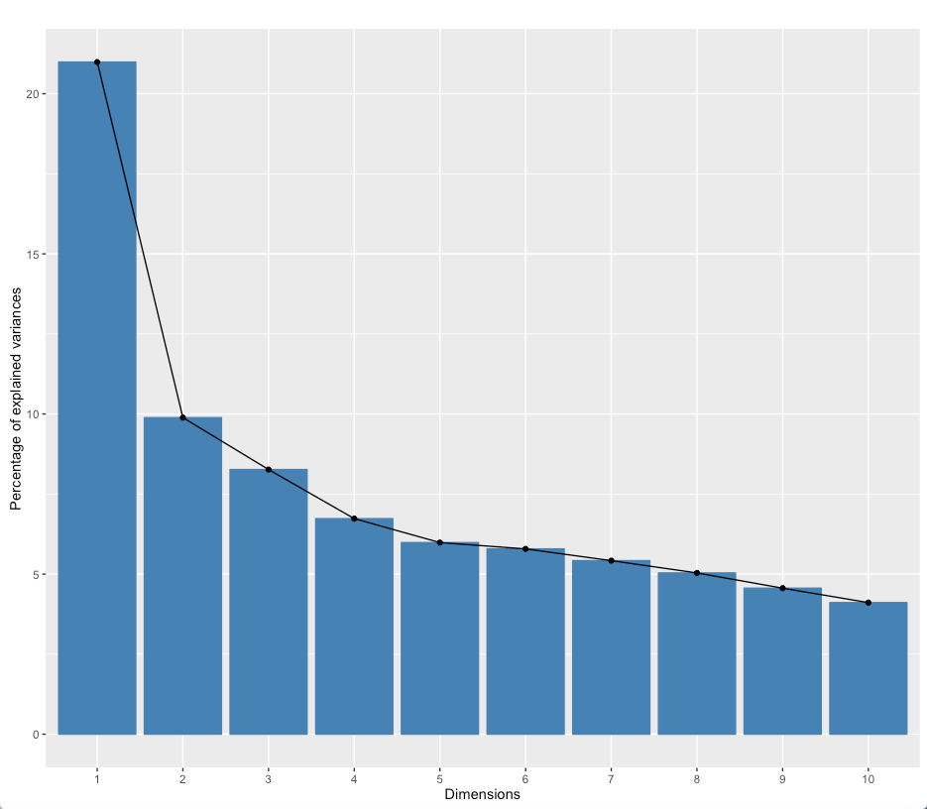
Webpanel 2015-2016

Slide 18
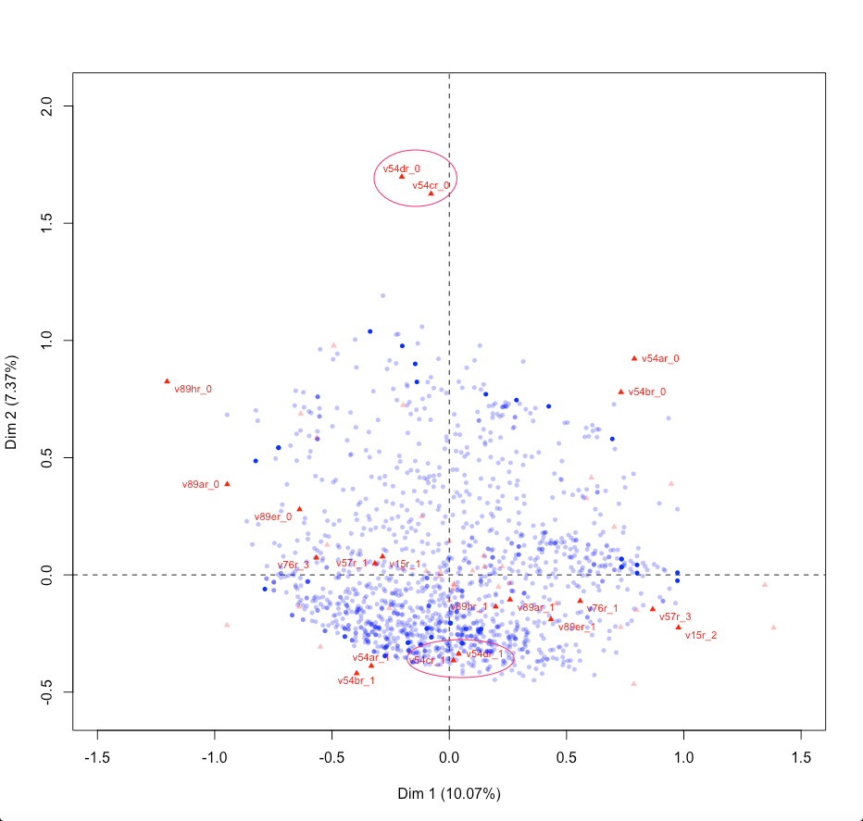
TSCS2013

Slide 19
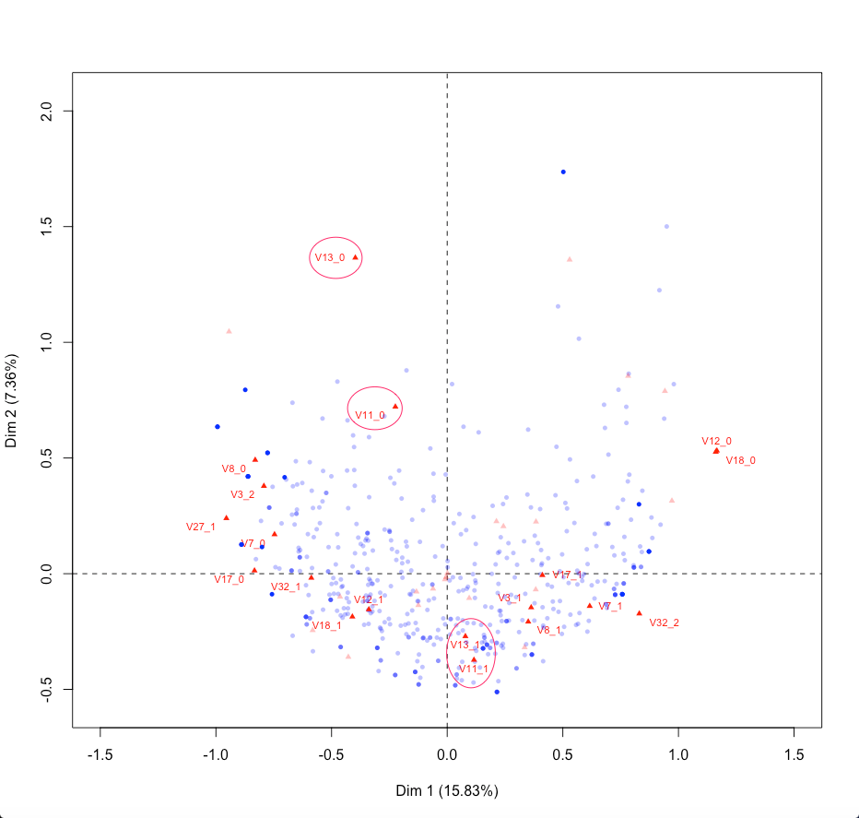
ID2015

Slide 20
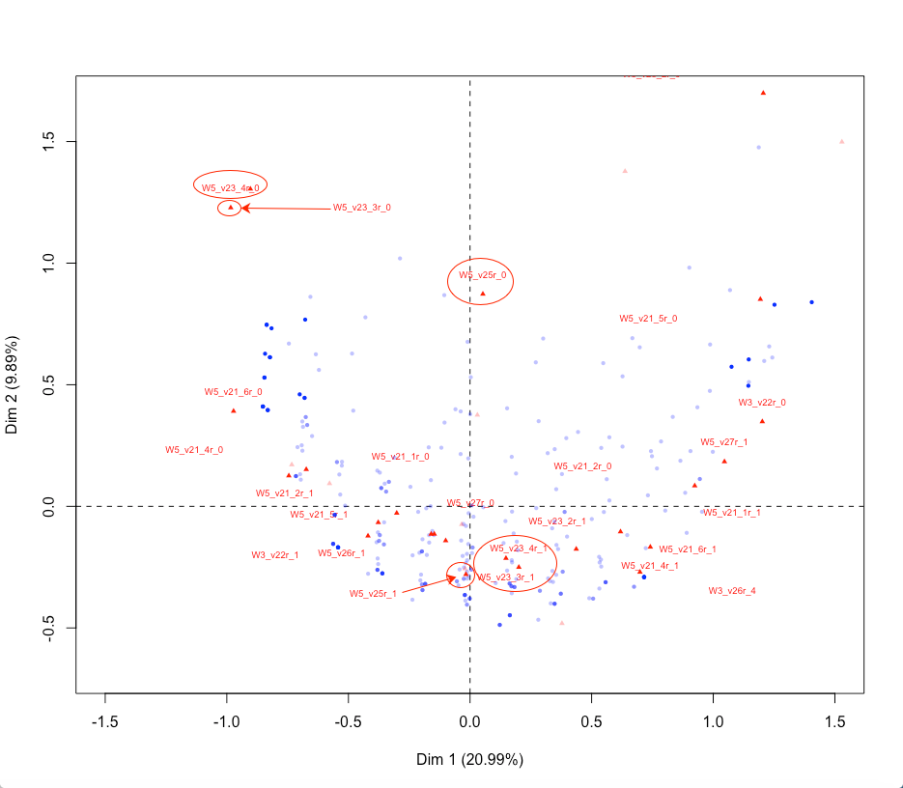
Webpanel 2015-2016

Slide 21
Summary (1): Measurements of National Identification
“Do you consider yourself as Taiwanese, Chinese, or both?"
“ The Chinese people consist of various ethnic groups, and those groups should not be isolated from one another perception about Chinese nation.”
“Taiwan has developed very different cultures that should no longer be regarded as part of Chinese culture.”
“The Chinese people consist of various ethnic groups, and those groups should not be isolated from one another.”
“Taiwanese people’s forefather is the Yellow Emperor (also called as Huang-di) from China, and we must inherit such an original and history."
“As the descendants of the Yellow Emperor, we should try our best to promote Chinese culture in the international community.”

Slide 22
Summary (2): Measurements of the 2nd Dimension
”End of the Ching Dynasty and establishment of the Republic of China is an important historical event and should be remembered by the next generation and forever.”
" The victory of the Second Sino-Japanese War is an important historical event and should be remembered by the next generation and forever.”

Slide 23
Summary (3): Conceptualization Failure
The commonly used simple "unification/independence” question can NOT be grouped into any of the top 10 dimensions.
Even the conditional unification/independence questions are NOT measurements of state but national identification:
  “If the independence of Taiwan would not lead to war, we should declare independence.”
  “If the economic, social and political development in China is more or less the same as development in Taiwan, there should be a cross-strait unification.”

Slide 24
Conclusions
MCA is a promising tool for conceptualization.
It is likely that most commonly used survey questions regarding Taiwan’s political future are linked to one concept: national/ethnic identification.
The concept of state/country identification has been under-studied and its measurements are worth exploration.
Time to Taiwan’s identity politics onto a radar with at least two axes,
  national identification: (Taiwanese-Chinese) and
  state identification: (accepting-rejecting) the legacy of ROC.

Slide 25
Discussion: unsolved puzzles
There are at least two survey questions that may compose the third concept:
  “Do you believe the status quo with respect to Taiwan already constitutes independence?”
  “Do you believe the people of Taiwan already have their own country?”

Slide 26
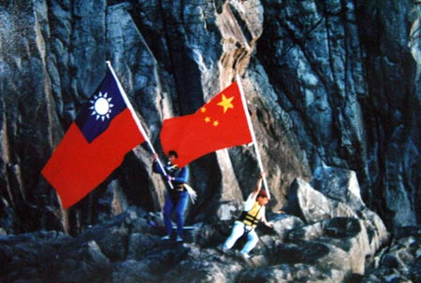
PRC vs. ROC? China vs Taiwan?

Slide 27
Not really. The issue in Taiwan is more close to a quarrel between “two nations” (Chinese nation vs. Taiwanese nation)
Are we talking about two states?

