Slide 1

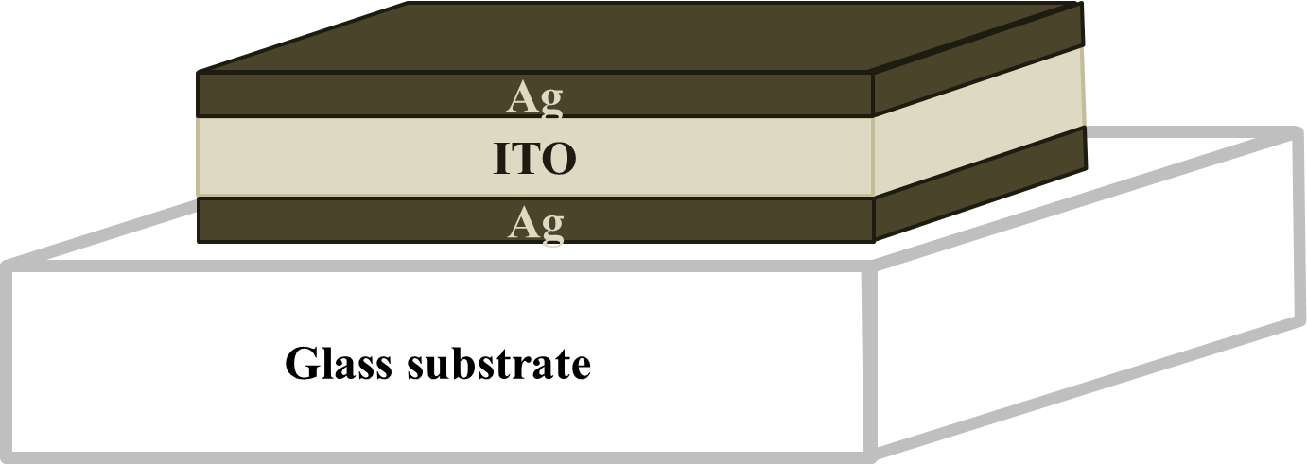
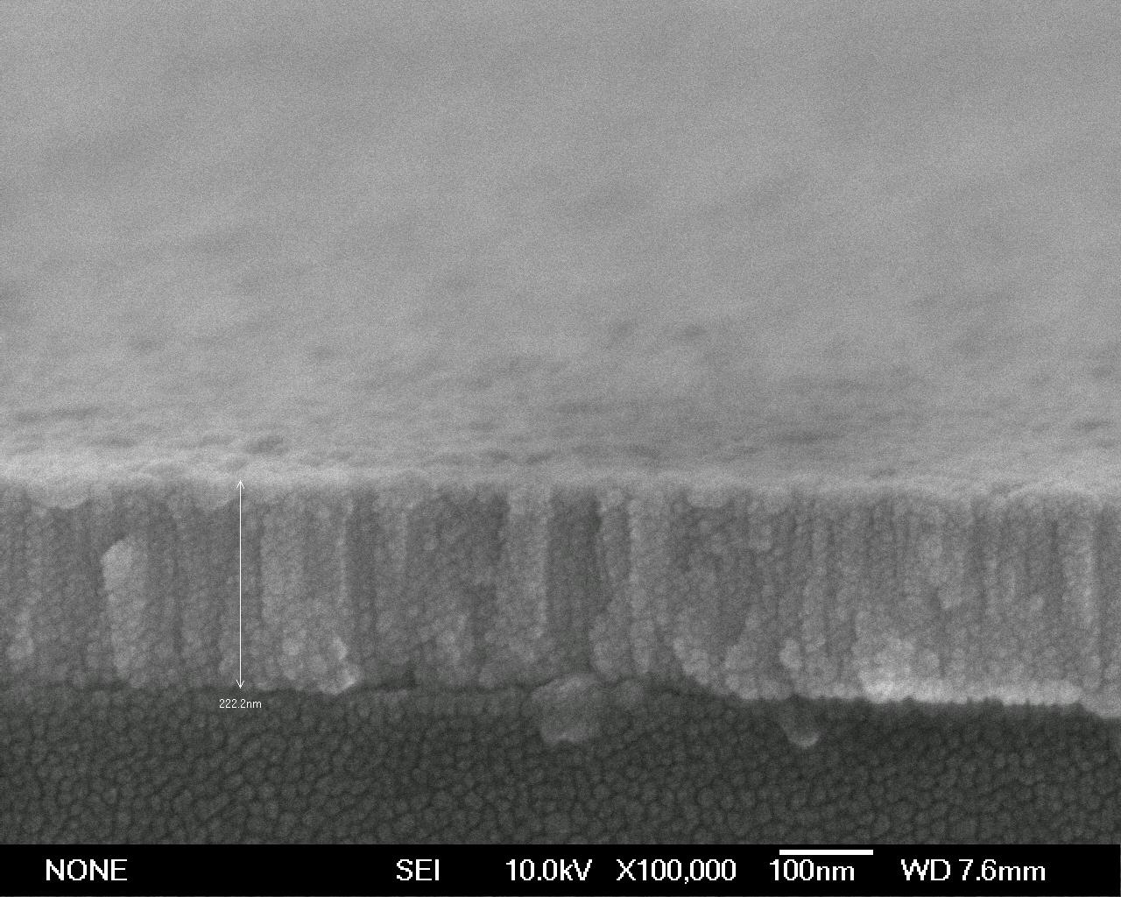
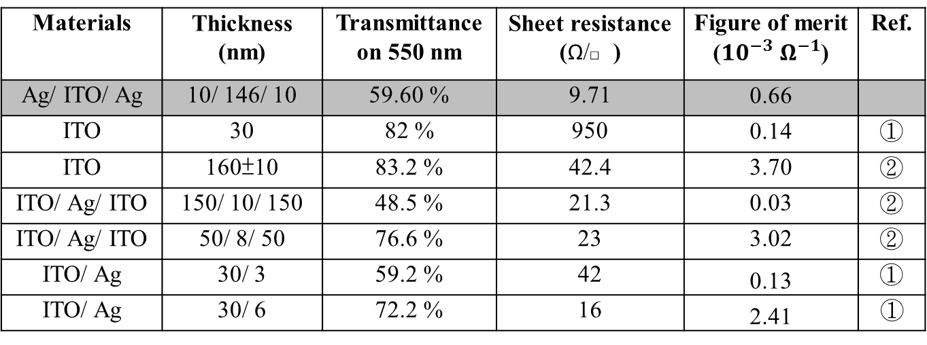
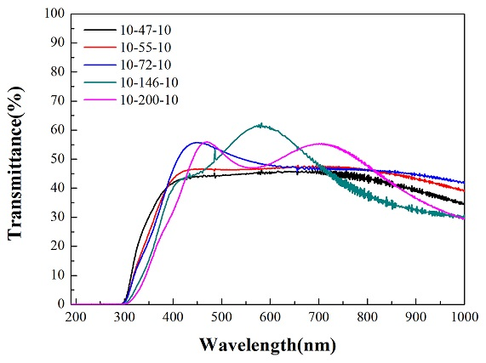
Research for fabricating high transmission transparent conductive thin film in Ag/ITO/Ag structure
A. C. Yu^{a,}*, J. H. Hsu^{a,}, J. C. Huangª
ª Department of Materials and Optoelectronic Science; Center for Nanoscience and Nanotechnology,
National Sun Yat-Sen University, Kaohsiung, Taiwan 804, ROC
* Corresponding and presenting author. Tel.: +886 7 5254070; fax: +886 7 5254099.
E-mail address: m023100013@student.nsysu.edu.tw (A. C. Yu)
Abstract
According to the fundamental of the optics and its extended concept, we recognize that the resonant cavity which makes the incident light reflected persistently inside is formed by the distinction of the refractive index of different kinds of the thin film layers. Using the appropriate thickness of the resonant cavity after the accurate calculation, most of the transmission light can form a constructive interference which can increase the percentage of transmission and retain the fine conductivity simultaneously. The most important essence of this research is to build a simulation of the theory of the above structure. In addition, we will use spectroscopy ellipsometers to measure the relation between refractive index and wavelength in every layers. With the aid of former simulation, we can find the perfected thickness of every layer in order to achieve both of high electric conductive and great optical transmitting TCTF.
Results and discussion
Figure 1. The illustration of Ag/ ITO/ Ag structure on glass substrate. It forms a cavity which could accumulate lights into structural interference, which can increase transmittance.
Figure 2. SEM images of the Ag/ ITO/ Ag structure. ITO is shown in the column shape and the Ag layers are on and below the ITO layer.
Figure 3. It shows the Figure of merit of each similar structure to Ag/ ITO/Ag structure. Optimizing Ag/ ITO/ Ag structure also shows one of the best transparent conductive film.
Figure 4. Transmittance of Ag/ITO/Ag structure which upper and lower silver layer are fixed in 10 nm, and changing thickness of ITO layer inside.
Conclusions
Transmittance can be increased by introducing oxygen into chamber when we deposit ITO layer on
samples. Settling 140 nm for the thickness of ITO layer in Ag/ITO/Ag structure can get the best
transmittance in the wavelength of 550 nm, and it fits the model calculating. Measure the electrical
resistance and substitute the value into figure of merit, this structure can also be shown as a good
transparent conductivity film.

