Slide 1
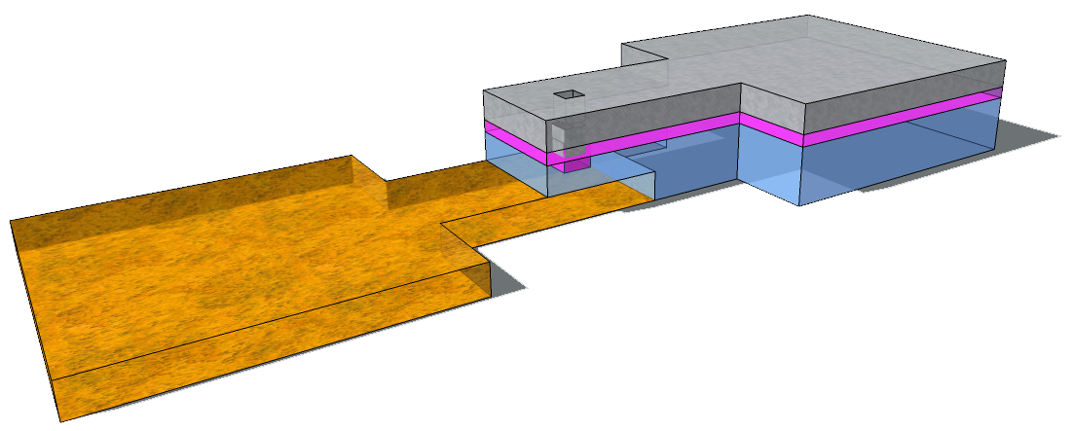




The Study of Material and Electrical Properties of Ag-Cu alloy thin films applied on RRAM
Sample
Different composition of AgCu alloy
XRD
AgCu
Ag(111)
Ag(111)
SiO₂
Cu(111)
Cu(111)
TiN
SiO₂
TiN
AgCu
Switching layer
V
Ag₄₂Cu₅₈
Ag₄₉Cu₅₁
Electrical results
XPS
Ag₄₉Cu₅₁
 | Ag | Cu
specimen1 | 42 | 58
specimen2 | 49 | 51
specimen3 | (25) | (75)
Ag₄₉Cu₅₁ & Ag₄₂Cu₅₈ &Ag₂₅Cu₇₅
Ag₄₂Cu₅₈
Preliminary summary
(Ag₂₅Cu₇₅)
1.The more Cu in composition, the more stable in I-V sweep.
2.The coexistence of unipolar and bipolar I-V sweep appears in all three composition.
C.C. 5mA

