Slide 1
A Thick Data Approach
How Exploratory Political Studies Advance Our Understanding about Politics?
Cheng-shan (Frank) LIU
Institute of Political Science, National Sun Yat-Sen University
MPSA Annual Meeting, April 6-9, 2017

Slide 2
Where are we standing?
What do empirical study scholars pursue in their research?
Positivists: theory development (causal inference)
Scientific Realists: mechanism
Pragmatists: solutions for solving practical problems
Interpretivists: representation of meaning

Slide 3
A missing promise: meaning mining
What if we prioritize drawing meaning from data as our purpose of research?

Slide 4
A new Conceptual map of knowledge generation

Slide 5
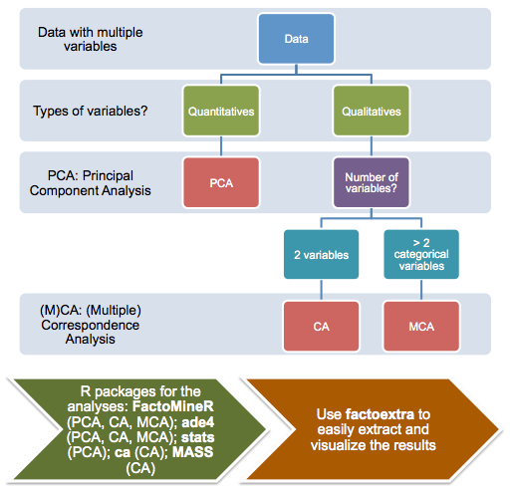

Slide 6
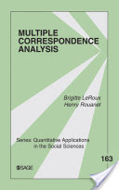
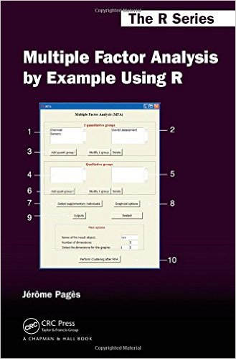
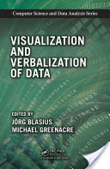

Slide 7
The distribution of Taiwan Voters along nationalism and perception about ROC (TSCS2013, N=1,952)

Slide 8
1st generation: Born before 1931

Slide 9
2nd Generation: Born 1932~1953

Slide 10
3rd generation: Born 1954~1968

Slide 11
4th generation: Born 1969~1978

Slide 12
5th generation: Born 1979~1988

Slide 13
4
5
1
2
3

Slide 14
While the 2nd generation start to doubt Roc legitimacy, the 5th has Redefine roc as Taiwanese people’s roc.
It is almost impossible to see this using conventional approach.

Slide 16
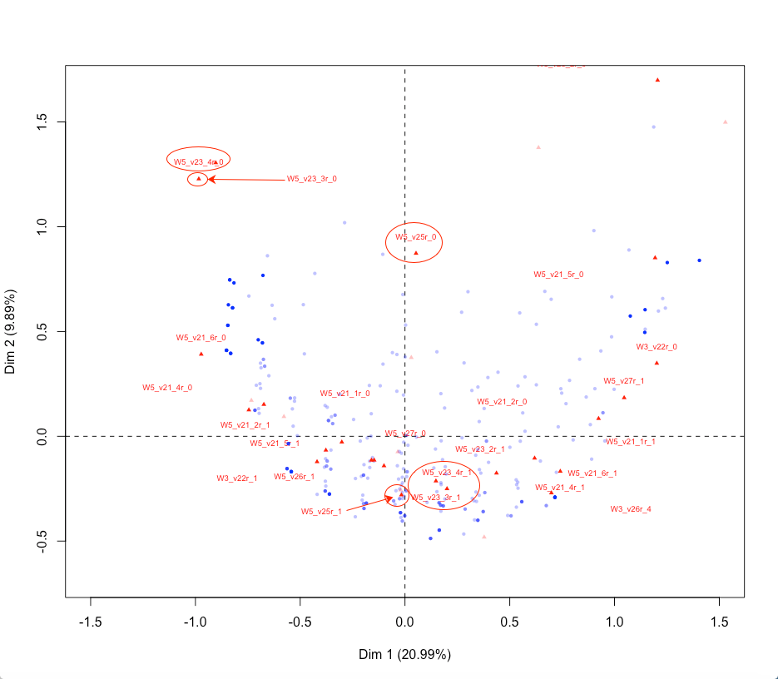
Webpanel 2015-2016

Slide 17
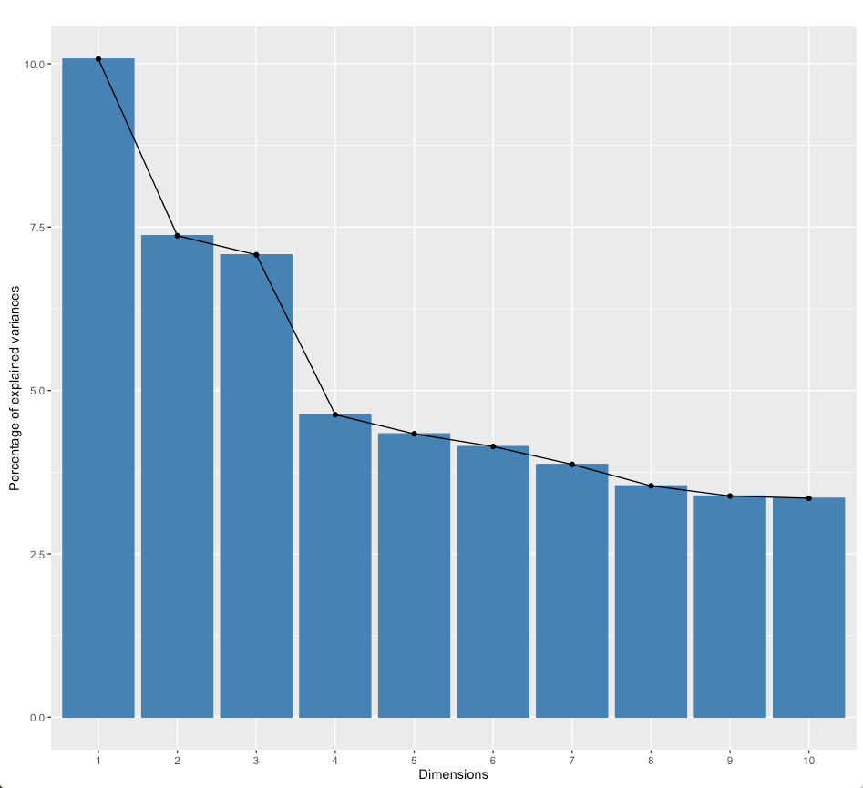
TSCS2013
TSCS2013

Slide 18
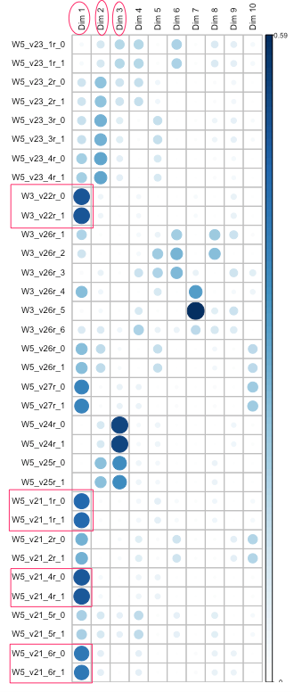
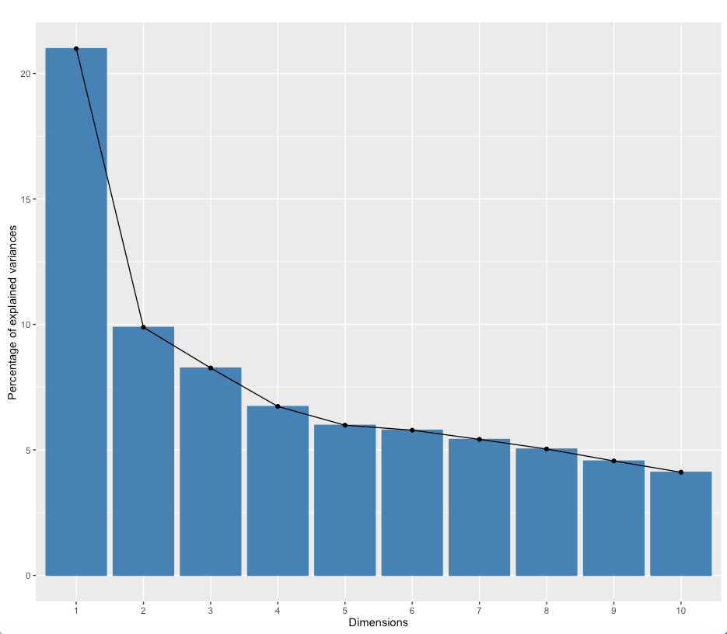
Webpanel 2015-2016

Slide 19
Concluding thoughts: 1. data Mining for data-based interpretation 2. thick data as An approach by which scholars could collaborate for meaning mining.

Slide 20
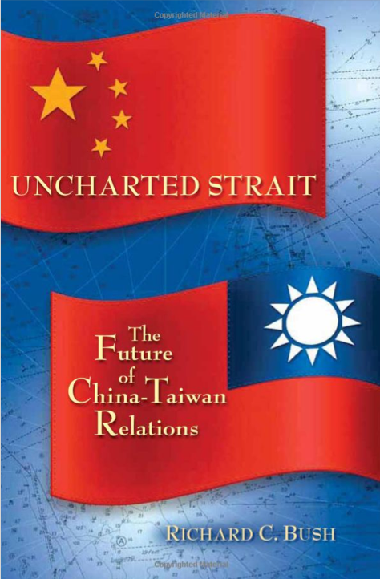
One Taiwan, One China?

Slide 21
Two Chinas?

