Slide 1
How Much should We Worry about the Polarization effect of Polarized News Media? Assessment with Agent-Based Simulation
Frank C. S. Liu
Institute of Political Science
National Sun Yet-San University, Kaohsiung City, Taiwan
Paper prepared for the Computing in Economics and Finance (June 20-22, 2015)
Taipei, Taiwan

Slide 2
Let’s analyze public opinion as a market of preferences,
Or a flow of water

Slide 4
The Empirical Puzzles
The public, especially the younger generation, becomes less interested in accessing political or electoral news.
Will it affects the environment that cultivates democratic citizenship? Why and Why not?

Slide 5
Research Qeustions
What if voters become less interested in watching, reading, or listening to political news but still habitually discuss politics?
What if voters become less interested in political discussion but still turn to the mass media for political information?
What if individuals become indifferent to both communication networks and news media and dive into electronic entertainment?

Slide 6
The Mechanism and Key Terms
News Access -> Heterogeneity in Political Surroundings -> Voting Behavior (Mutz & Martin, 2001)
Heterogeneity in political surroundings: the level of an individual’s subjective perception of the composition of their networks
Political disagreement: inconsistency between the of the focal respondent and those of the discussants within her political surroundings.

Slide 7
Hypothesis 1
If citizens becomes less interested in accessing news sources but remain interested in discussing politics (“no pebble in a swirl”), the proportion of individuals who perceive network heterogeneity will decrease.
[influenced by their self-selected opinion leaders]

Slide 8
Hypothesis 2
If citizens becomes less interested in discussing politics but remain interested in accessing the self-selected news media (“many pebble no swirl”), the proportion of voters who perceive network heterogeneity will increase.
[avoidance of social network homogenization]

Slide 10
Internal Validation of the Model
John Zaller’s (1992) Receive-Accept-Sample (RAS) model.
The reception axiom (Axiom 1): the politically aware or political experts are more conscious of political issues and are more likely to acquire political information actively.
The resistance axiom (Axiom 2) indicates that the awareness of political information determines one’s propensity to reject incoming political information.

Slide 11
Internal Validation of the Model
The accessibility axiom (Axiom 3) : individuals base their statement of preference on information recently stored in their memory.
The response axiom (Axiom 4) : individuals sample these stored messages to form their attitudes by “averaging across the considerations that are immediately salient or accessible to them”

Slide 12
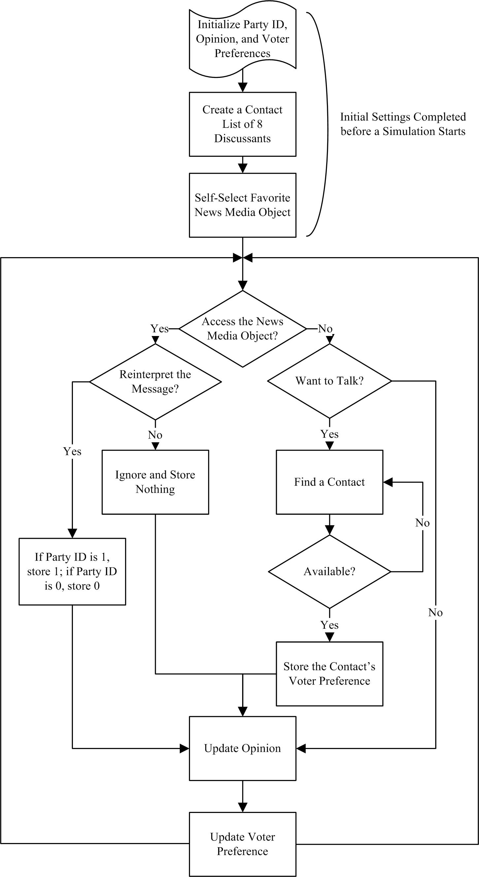

Slide 14
Two Types of Citizen Agents
Notes:
14

Slide 15
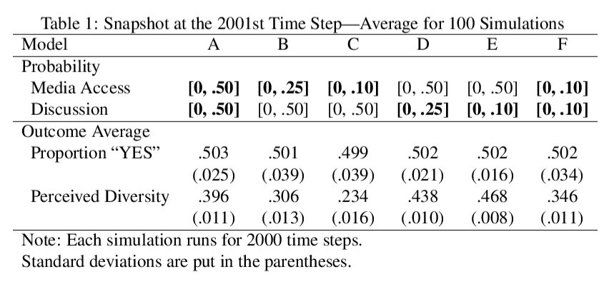

Slide 16
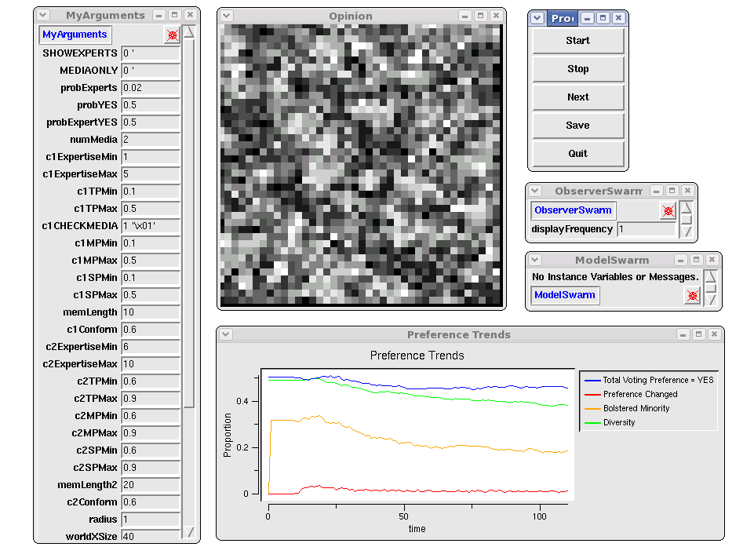

Slide 17
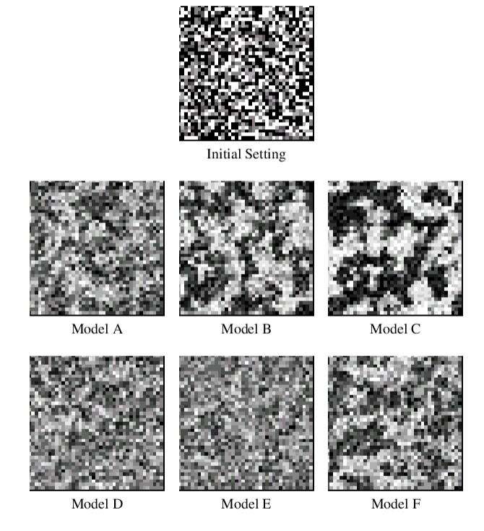

Slide 18
Major Findings and Discussions
The decline in political news access will decrease the number of individuals who perceive heterogeneity in voter preference
involvement in political discussion decreases a society-wide perception of heterogeneity in voter preference
Citizens are subject to the influence of swirls and the news media plays a role of keeping opinions surrounding pebbles.

Slide 19
If Swirls Only

Slide 20
Media, Pebble, and Swirls

