Slide 1
Democratic Zeal, Fake News Worries, and Moralized Preferences: Inspecting Taiwan’s Polarization Patterns
Frank C.S. Liu
NSYSU, Taiwan ROC
May 8, 2019
Taiwan Studies Chair @ KU Leuven
csliu@mail.nsysu.edu.tw

Slide 2
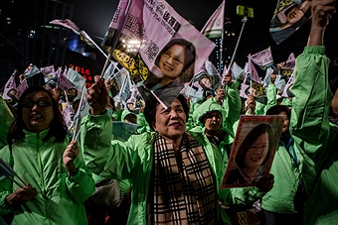
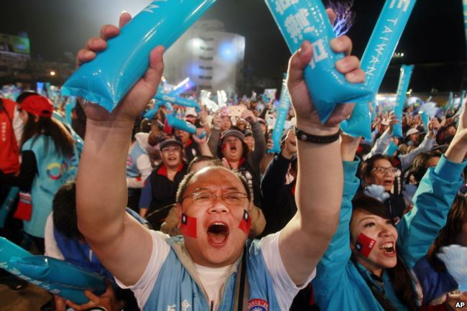
Democratic Zeal
Is democracy Taiwan voters’ prioritized (moral) value?

Slide 3
Francis Fukuyama (1992, 1995, 2012, 2014, 2015, 2018)

Slide 4
Fukuyama, F. (2018). Identity: The Demand for Dignity and the Politics of Resentment. New York: Picador.

Slide 5
Levitsky, S., & Ziblatt, D. (2018). How Democracies Die. New York: Crown.

Slide 6
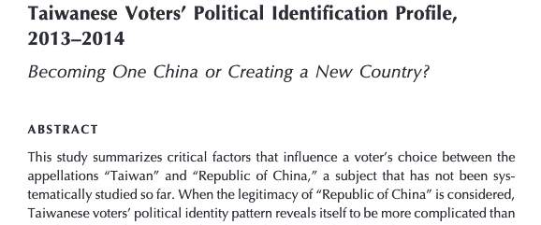
Can we go beyond the scope of political identity?

Slide 7
Could democracy be the cause of its own destruction?
How Taiwan’s experiences contribute to
the understanding about democratic recession?

Slide 8
Partisans vs. non-partisans (independents)
Most self-claiming non-partisans or intendent voters are less likely to be pure independent voters than “closet partisans”
Very little attention has been paid to whether or not and how partisanship and orientation toward rejecting party identity associate with their views about democracy.

Slide 9
MCA for thickened data Studies
Put individuals on to Scatterplot for visual analysis
Find out potential relation between variable (categories)
Evaluate the connection between concepts and measurements

Slide 10
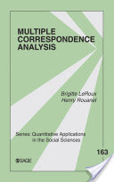
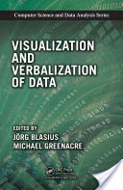
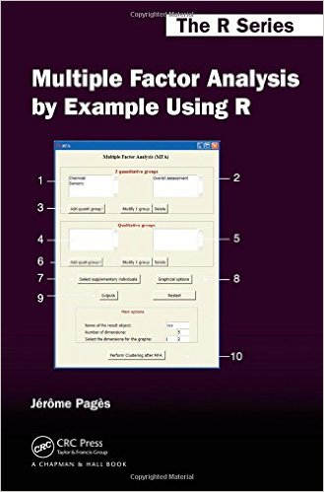
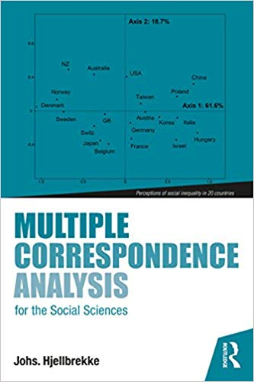

Slide 11
Representative Data for Exploratory Data Analysis
Taiwan’s Election and Democratization Study: Survey of the 2016 Presidential and Legislative Elections (TEDS2016)
January 17 ~ April 28, 2017 (N=1,690).

Slide 12
25 Survey Questions drawn from TEDS2016
How closely do you follow politics on TV, radio, newspapers, or the Internet?
How interested would you say you are in politics?
Some people say: “People like me don’t have any say about what the government does”.
Some people say: “Sometimes politics seems so complicated that a person like me cannot really understand what is going on.”
Some people say: “Public officials do not care much about what people like me think.”
Some people say: “Most decisions made by the government are correct.”
Some people say: “Government officials often waste a lot of money we pay in taxes.”

Slide 13
When the government decides important policies, do you think “public welfare” is its first priority?
You feel you understand the most important political issues of this country.
Most politicians are trustworthy.
Politicians are the main problem in our country (i.e. Taiwan).
Having a strong leader in government is good for our country even if the leader bends the rules to get things done.
The people, and not politicians, should make our most important policy decisions.
Most politicians care only about the interests of the rich and powerful.

Slide 14
Would you say that over the past twelve months, the state of the economy in Taiwan has gotten much better, gotten somewhat better, stayed about the same, gotten somewhat worse, or gotten much worse?
Would you say that in the forthcoming year, the state of the economy of Taiwan will get better, stay about the same, or get worse?
Different people have different opinions about voting. Some people think that voting is a responsibility, and you should vote even if you don’t like any of the candidates or parties. Other people think that it is all right to vote or not to vote, and the decision depends on how you feel about the candidates or parties. Do you think that voting is a responsibility, or do you think that it is all right either to vote or not to vote?
Which of these three statements is closest to your own opinion? 1 Democracy is preferable to any other kind of regime; 2 In some circumstances, an authoritarian regime – a dictatorship can be preferable to a democratic system. 3 For someone like me, it doesn’t matter what kind of regime we have.

Slide 15
Some people say that no matter who people vote for, it won’t make any difference to what happens. Others say that who people vote for can make a big difference to what happens. Where would you place yourself? (a 5-point scale)
In Taiwan, some people think they are Taiwanese. There are also some people who think that they are Chinese. Do you consider yourself as Taiwanese, Chinese or both?
Do you believe that cross-Strait relations will become warmer, more tense, or remain unchanged?
I like to know what you think about each of our political parties. After I read the name of a political party, please rate it on a scale from 0 to 10, where 0 means you strongly dislike that party and 10 means that you strongly like that party. If I come to a party you haven heard of or you feel you do not know enough about, just say so. The first party is KMT. (a 10-point scale)
Using the same scale, where would you place, DPP?
Q1. Do you usually think of yourself as close to any particular party? Q1a. Do you feel yourself a little closer to one of the political parties than the others?

Slide 16
Two factors / latent variables emerge from the combination of the set of the 25 survey questions.

Slide 17
Major Components of “Trust in Government” (X-axis)
(dis)trust of politicians
“most politicians care only about the interests of the rich and powerful”
“politicians are the main problem in our country”
“most politicians are trustworthy”
(dis)trust of public officials
“public officials do not care much about what people like me think”
“government officials often waste a lot of money we pay in taxes”
(dis)trust in government
political self-efficacy
political interest

Slide 18
Major Components of “Zeal for Democracy” (Y-axis)
Party identification with the DPP or KMT
ethnic identity
prospective views about economy
democracy as a preferable regime
voting matters
voting as a responsibility
interest in politics

Slide 23
Data for 2nd Stage Exploratory Data Analysis
Taiwan’s Election and Democratization Study: Survey of the 2018 Presidential Election (TEDS2008P)
June 17 ~ August 12, 2008 (N=1,905).
Yes, it is a representative sample.
16 questions drawn to match TEDS2016

Slide 25
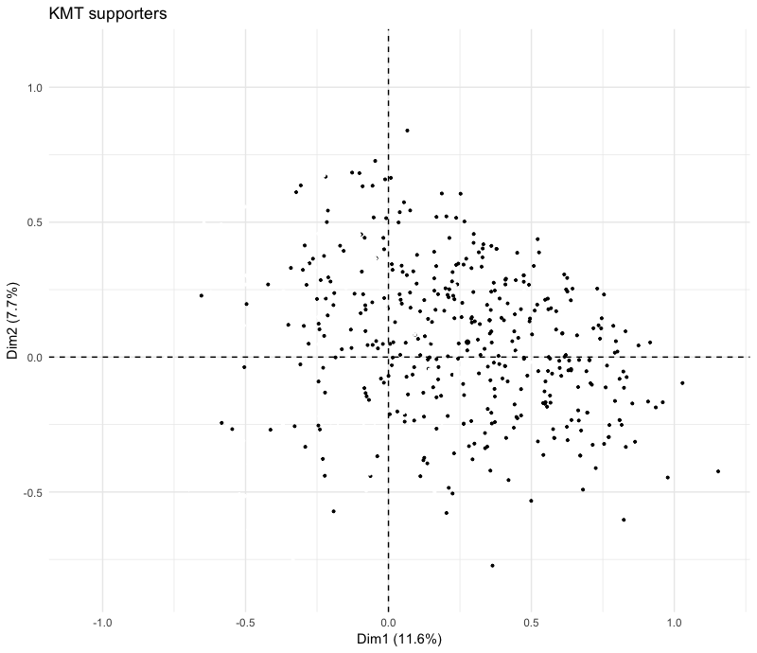
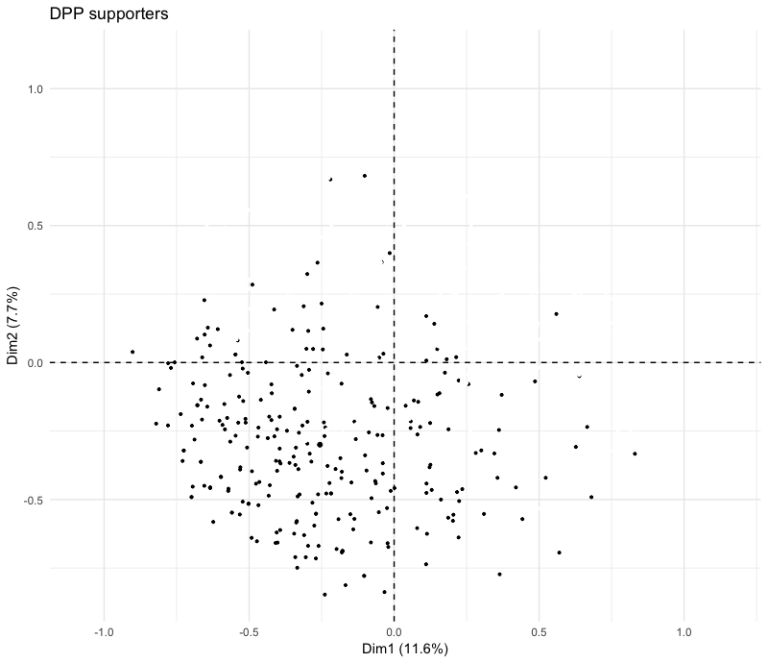

Slide 26
微笑小熊調查小棧 smilepoll.tw
Since 2012
Member >8,000
3 to 4 surveys per month
800 to 1,200 respondents for each survey
Web panel for EDA and experiments

Slide 27
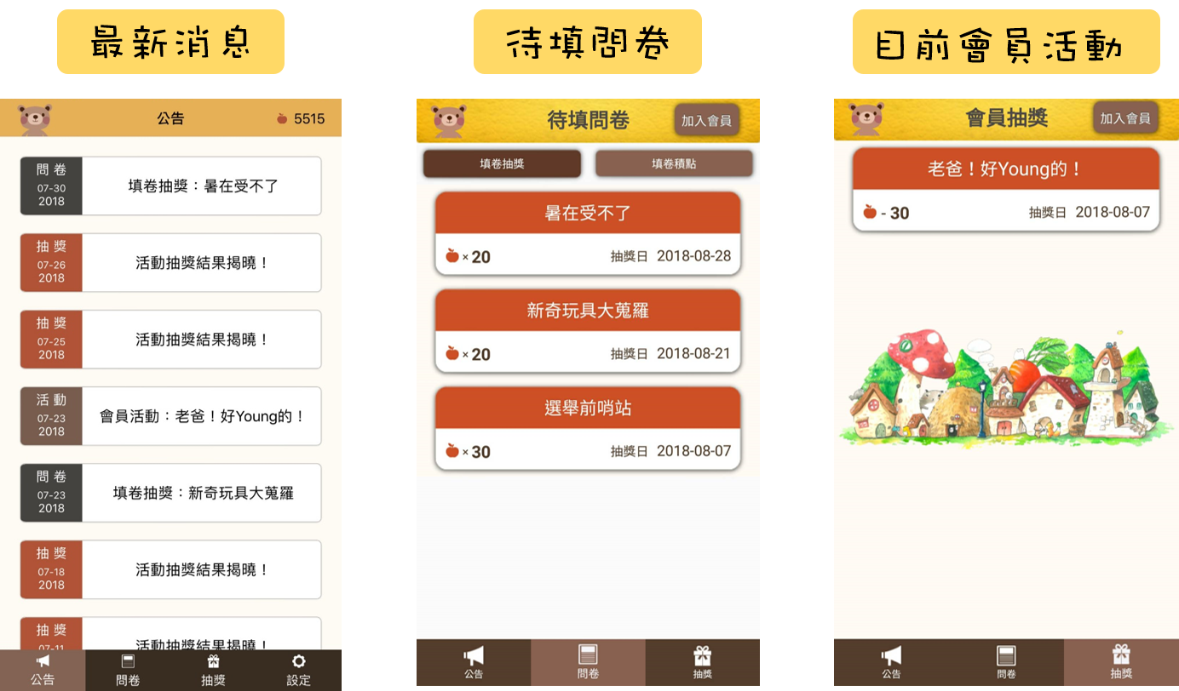
App Interface

Slide 28
Web Sample Nov. 11~29, 2016

Slide 29
Polls seem to be trusted…

Slide 30
and necessary for democracy

Slide 31
But they are not seen fair and objective…

Slide 32
Polls are political.

Slide 33
Web Panel Data for Exploratory Data Analysis
C: 2018.10.29 ～ 11.20, N=1,378 （74%）
D: 2019.01.21～ 2019.02.19, N=1,297 （78%）
C+D, N=690

Slide 35
Tentative Conclusion
Partisan’ polarization has taken shape
It is not about democracy vs. anti-democracy
It is about pro-democracy vs. pro-trusting political institutions
Indifference to politics is associated with indifference to democracy
Misinformation about this pattern could lead to social polarization
One’s awareness of fake news prevalence is associated with concerned about democracy.

Slide 36
Discussion

Slide 37
Populism yet?
Think about KMT supporters’ value other than democracy.

Slide 38
Beijing’s role in Taiwan’s partisan competition
KMT supporters’ perception about efficient government vs. democratic government

Slide 39
Exploratory data analysis approach for theory development
Data-assisted meaning netting (DAMN)

Slide 40
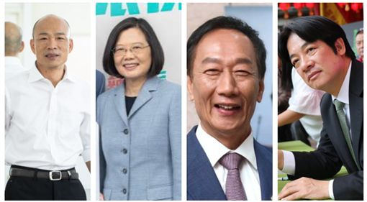
moral value competition for 2020
A president with charismatic leadership vs. a president emphasizing democracy values

Slide 41
“We need to protect our democracy!” vs. ”We want to follow a patriotic leader!”
The battle will be parties’ calls for their own moral voters, not for independent voters.

Slide 42
Future Studies
Robustness check with more constructed datasets
Creative variables + MCA for more meanings
cross-national comparison for theory development

Slide 43
Reference
Achen, C. H., & Bartels, L. M. (2017). Democracy for Realists: Why Elections Do Not Produce Responsive Government (Reprint edition). Princeton, New Jersey: Princeton University Press.
Blasius, J., & Greenacre, M. (Eds.). (2014). Visualization and Verbalization of Data. CRC Press.
Fukuyama, F. (2018). Identity: The Demand for Dignity and the Politics of Resentment (Reprint edition). New York: Picador.
Husson, F., Le, S., & Pages, J. (2010). Exploratory Multivariate Analysis by Example Using R (1 edition). CRC Press.
Lakatos, Z. (2015). Traditional values and the Inglehart constructs. Public Opinion Quarterly, 79(S1), 291–324.
Levitsky, S., & Ziblatt, D. (2018). How Democracies Die. New York: Crown.
Pagès, J. (2014). Multiple Factor Analysis by Example Using R (1 edition). Boca Raton: Chapman and Hall/CRC.
Pasek, J., Jang, S. M., Cobb, C. L., Dennis, J. M., & Disogra, C. (2014). Can marketing data aid survey research? Examining accuracy and completeness in consumer-file data. Public Opinion Quarterly, 78(4), 889–916.
Rice, C. (2016). Democracy in Decline? (Reprint edition; L. Diamond & M. F. Plattner, eds.). Baltimore: Johns Hopkins University Press.
Roux, B. L., & Rouanet, H. (2009). Multiple Correspondence Analysis. SAGE Publications.
Runciman, D. (2018). How Democracy Ends. New York, NY: Basic Books.

Slide 44
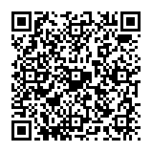
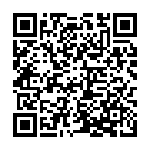
collect data with smilepoll.tw: littlesmilebear@gmail.com
Smilepoll.tw
iOS App
Android App

